Slide 1
Distributed Parallelism
SET10108 Concurrent and Parallel Systems

Slide 2
Breakdown
Single Machine Concurrency
Multiple Machine Concurrency
Distributed Memory Interconnects
Thinking in Distribution

Slide 3
Single Machine Concurrency

Slide 4
Single Machine Concurrency
Up until now everything we have done has existed on a single machine
Multithreading
OpenMP
SIMD
Apart from SIMD, single machine parallelism wasn’t really an issue until fairly recently
Multicore processors
Most of our work up until this point has focused on spreading work across cores and controlling memory

Slide 5
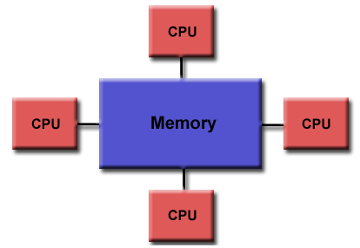
Shared Memory
Shared memory is an inherently useful concept when dealing with single-threaded applications
Performance
Easy to understand
Shared memory becomes tricky in light of concurrency
We use control mechanisms
However, shared memory is still the way programmers think

Slide 6
Machine Boundary
Up until now everything we have done has existed in a single machine
Multiple cores
Shared memory
Shared resources
This is self contained – you have been building applications like this for years now
Easy to understand
Simple to manage
Our problem is that many of our models break down in the face of distribution

Slide 7
Object-orientation and Distribution
One of the biggest problems we now face is working in reference / pointer based object-orientation and distribution
We are used to the idea of reference / pointer passing, manipulating data directly, and other objects being able to see the result
Single machine, shared memory
This model completely breaks down in the face of distribution
No shared resources
Copies of objects sent across the network
Our job will be to deal with distribution – we will basically stop working in object-orientation at this point

Slide 8
Multiple Machine Concurrency

Slide 9
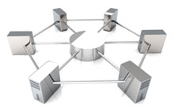
Multiple Machine Concurrency
Let us now start thinking about using multiple machines in our parallel applications
When we have multiple machines, we effectively add more hardware to our problem
More CPU power
More memory
However, this isn’t going to just give us processing power that easily

Slide 10
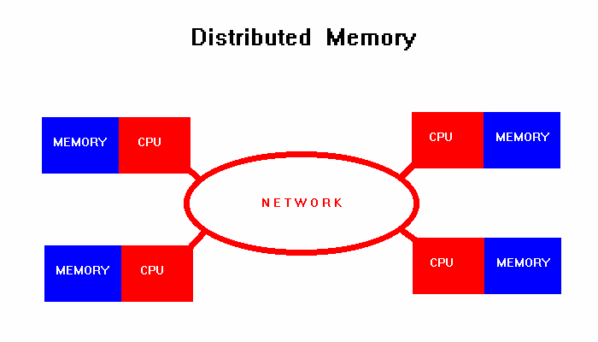
Distributed Memory
Distributed memory leads us to a number of other considerations
How do we communicate with other CPUs?
How do we control access to our memory across the network
If shared memory is a problem on a single machine, then distributed memory is the problem on multiple machines

Slide 11
Machine Boundary
Our machine boundary now comes into play
Each machine has a CPU and memory
Each machine can compute by itself
Once we start working across our machine boundary, we bring a collection of problems
Aliasing of memory (referencing) breaks down
Copying of memory between machines
Coordinating across multiple machines
These can be difficult to deal with depending on the problem at hand

Slide 12
Remote Memory Access
One popular method for distributed computing is providing a mechanism to invoke procedures on other machines
Remote Procedure Calls
One Sided Communications
This is the typical object-oriented approach to the problem
An object exposes its interface to the network
Remote objects can invoke its methods
The Internet is built on this approach
Service-orientation
Web resources

Slide 13
Message Passing
A different approach to communication is to consider the use of direct messages
You should be familiar with this idea
A process can just send a message to another process using some form of messaging system
We will do this using MPI
Inherently easier to implement and deal with, it doesn’t generally abide to object-orientation concepts
So breaks down when trying to work in object-orientation

Slide 14
Channel Communications
For those of you have used the networking capabilities of JCSP (the part I wrote) we overcome a number of problems
We are already dealing with channel communications – a networked channel looks no different to a process than a normal channel
We don’t share memory – we communicate messages. Copying is implicit in the model
Synchronisation (coordination) works in the same manner
JCSP does have its limitations however
Slow
A bit cumbersome

Slide 15
True Distributed Memory
The solution for object-oriented / shared memory programmers
Those who can’t think in parallel
Partitioned Global Address Space (PGAS) languages try and create a system where memory is globally addressable across the distributed system
Local variables are local memory
Global variables are global memory
Few research projects out there – they are slow and cumbersome however
People can be slow to change models

Slide 16
Parallel versus Distributed
Before moving on we should distinguish the difference between parallel computing and distributed computing
This is a generalisation, but we can think of the distinction as follows:
Parallel computing means that we have shared memory
Distributed computing means we have distributed memory
We will be working with MPI, so technically we are distributed. However, MPI is considered a parallel programming framework
I like to use the term distributed parallelism

Slide 17
Distributed Memory Interconnects

Slide 18
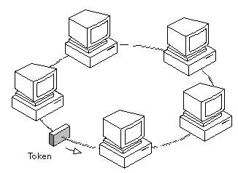
Ring

Slide 19
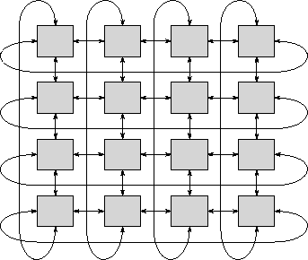
Toroidal Mesh

Slide 20
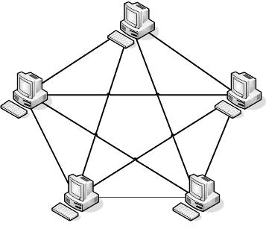
Fully Connected Network

Slide 21
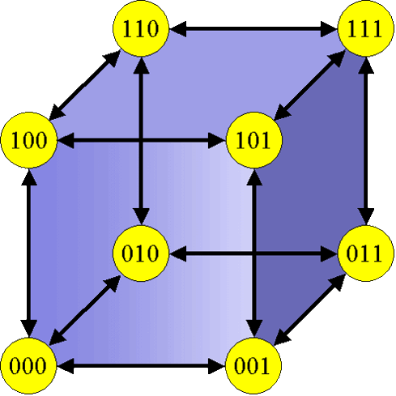
Hypercube

Slide 22
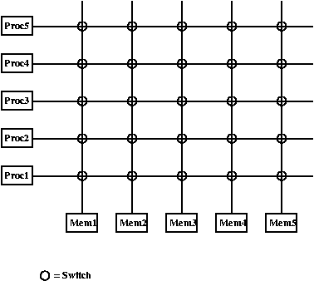
Crossbar Interconnect

Slide 23
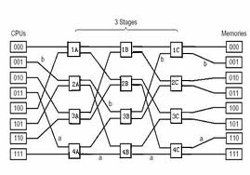
Omega Network

Slide 24
Thinking in Distribution

Slide 25
Differences in Communication
Up until now we have been doing direct memory access to work with data
This is stupidly fast
Our problem in distribution is that we are radically slowing down communication
100 Mbit networks are standard
1 Gbit networks are common
Because of this, we have to introduce new constraints on our applications

Slide 26
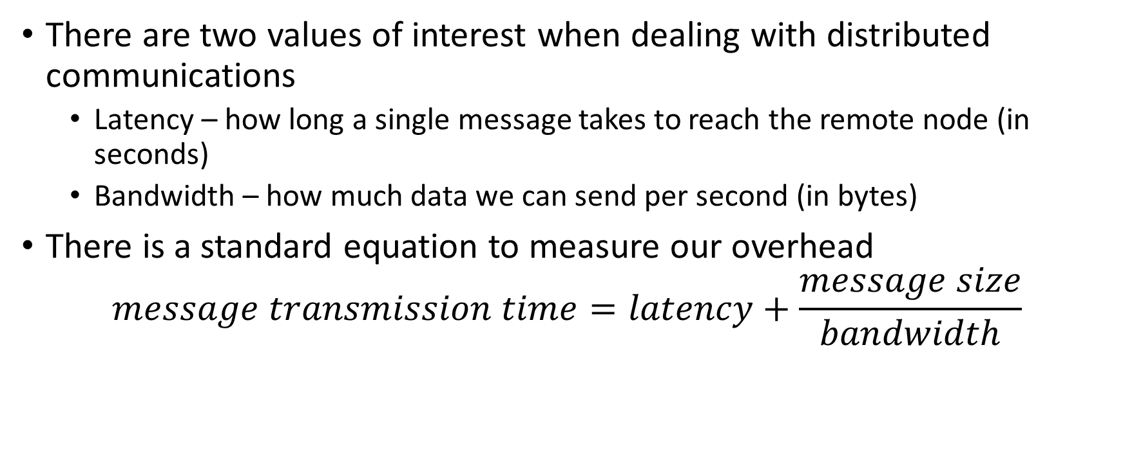
Latency and Bandwidth
There are two values of interest when dealing with distributed communications
Latency – how long a single message takes to reach the remote node (in seconds)
Bandwidth – how much data we can send per second (in bytes)
There is a standard equation to measure our overhead
$$message transmission time=latency+\frac{message size}{bandwidth}$$

Slide 27
I/O Bound vs CPU Bound
We now get into the interesting realm of I/O bound versus CPU bound computation
We can get this on single machines if we doing excessive I/O on screen or to the file system
When you deal with distribution you have to consider the following
Transmission time of data to remote machine
Transmission time of result from remote machine
Processing time on remote machine
If these three tasks combined will take longer than it would to compute locally then don’t distribute

Slide 28
Recommended Reading
Chapter 2 of Introduction to Parallel Computing goes into far more detail than we have here

Slide 29
Summary
Distribution is a relatively cheap method of gaining parallelism. However, you have to think of the following issues
The difference between single machine and multiple machine concurrency
The type of communication you are using
The network involved
Latency and bandwidth issues
You really have to consider your work here – think about whether distribution is going to be advantageous
And if in doubt measure

